Slide 1
Klinik für Allgemein-, Viszeral-, Endokrin-
und Transplantationschirurgie

Slide 2
Beckenboden-Symposium 07.03.2024
Gabriele Bauci, Facharzt Chirurgie FMH

Slide 3
In Many Cases, the Mesh Brings Relief
Introduction
Methods
Results
Discussion

Slide 4
Introduction
Transvaginal mesh/ Abdominal route
Unclear which type of mesh should be used
Sueing organisation (Union) has no competence in medicine
UK Independent Report 2020
700 patients (which suffered harm from medication OR surgery)
Specialist Mesh-centers (Colorectal surgeons with special interest in pelvic floor)
Transparency concerning financial relationships
National Database
Notes:
As told on a debate on the ESCP 2023 in Vilnius: NHS is struggling with waiting list for some kind of operations. Going privatly for the operation (between 1500 and 9000 Pounds→suing the system →no payment

Slide 5
Introduction
Pelvic floor descensus mainly affects women after the menopause, leading to a combination of faecal and urinary incontinence, dyspareunia, and evacuation disorders.
The aim of my speech is to present our peri- and postoperative data after interdisciplinary and surgical management of pelvic floor prolapse (POP).

Slide 6
Introduction LVMR (laparoscopic ventral mesh rectopexy)
Is the «Mesh-Problem» a real problem?
Is the LVMR the best Option (or the only Option)?
Are out there better alternative to LVMR?
What is the State of the Art according to the Guidelines?

Slide 7
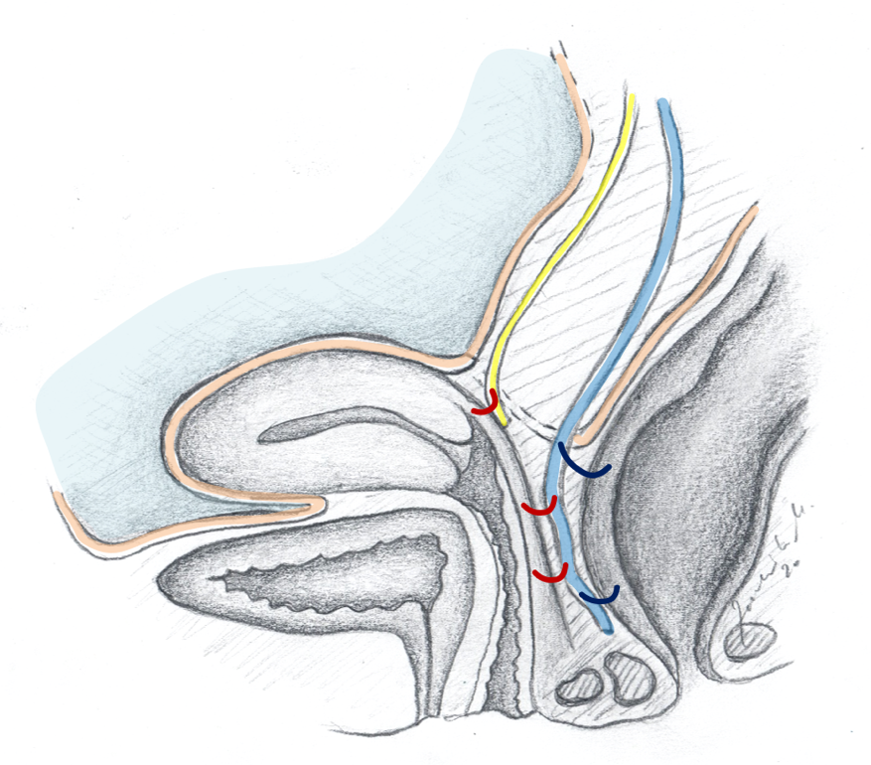
Methods
2012-2024
Patients who underwent interdisciplinary combined anterior colpopexy and ventral mesh rectopexy (Chir+ Gyn) = 56
Patients who underwent ventral mesh rectopexy and Douglasobliteration alone = 240
Follow-Up with clinical examinations and questionnaires
6 Weeks
6 Months
1 Year
2 Years
5 Years
10 Years

Slide 8
Methodes
«surgical» ventral mesh rectopexy
«interdiscipinary» procedure

Slide 9
Methods
Clinic intern Database collecting up to 150 different facts p. patient
Prospective data collection
Retrospective data evaluation
From 2018 on: just PVDF-Mesh (Dynamesh PPR visible)
Operation only:
If pelvic floor exercises and medical therapy did not help
Or complete rectal prolapse

Slide 10
Results surgical LVMR only
No severe complications (Clavien-Dindo ≥4) occurred postoperatively
90-day mortality was 0%
Satisfaction 8.4/10 Points for complete prolapse
Age (Years - Range) | 69.5‡ (41.5-86.9)
ASA (Score) | 60% ASA II, 21% ASA III, 19% ASA I
BMI (Kg/m2 - Range) | 25‡ (19.5 - 40)
Hospitalisation (Days - Range) | 6‡ (4 - 12)
Satisfaction Post-OP (Max. 10 Pts.) | 8.4* (± 2)
Follow-up (Months - Range) | 56‡ (0.5 - 120)
median:‡, mean:*

Slide 11
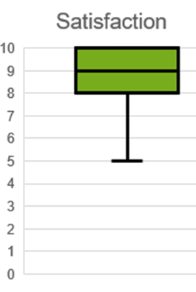
Results interdisciplinary Mesh-Rectopexy
No severe complications (Clavien-Dindo ≥4) occurred postoperatively
90-day mortality was 0%
Satisfaction 8.2/10 Points
‡
‡
‡
*(± 2)
‡(4-170)
median:‡, mean:*
Notes:
The rates of complications after laparoscopic ventral rectopexy vary in the literature, depending on the patient population, the surgeon's experience, and the follow-up duration. However, to provide a general idea:
Mesh-related complications: The rate of mesh erosion or infection is relatively low, reported in less than 5% of cases in most series. Mesh migration is even less common.
Bowel dysfunction: New or worsening constipation occurs in approximately 15-20% of patients, though this rate can vary widely. Improvement in bowel function is noted in many patients over time. Fecal incontinence improvement rates are high, with significant improvements seen in 70-80% of patients, depending on preoperative symptoms and definitions used in studies.
Sexual and urinary dysfunction: Postoperative sexual and urinary dysfunction rates are low, typically reported in less than 10% of patients. These issues often improve over time without further intervention.
Operative complications: These can include bleeding, injury to surrounding organs (such as the bladder, ureters, or rectum), and nerve damage. The rate of such complications is generally low, estimated to be less than 5%.
Recurrence of prolapse: The rate of recurrence varies but is generally reported to be between 5% and 10% in the longer term.

Slide 12
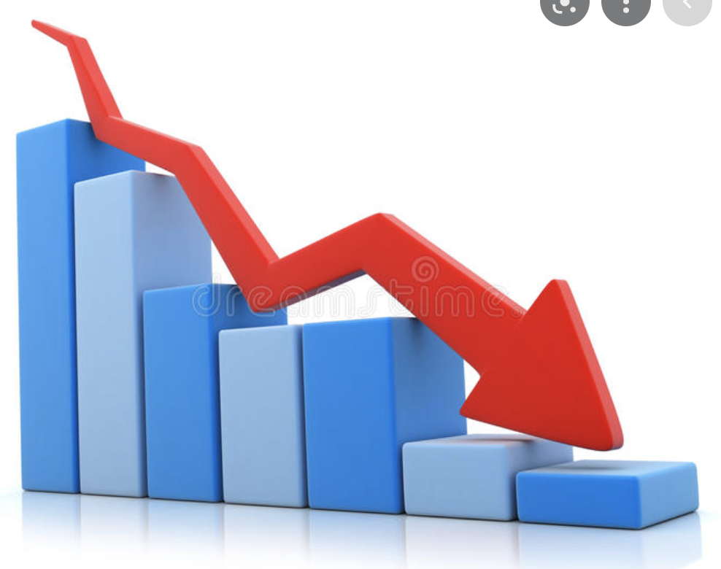
Adverse events
Surgical procedure only
7 Mesh Tightening
Stoma for a rectovaginal Fistula (rejoined later on)
1 Revision for intestinal obstruction
1 mesh exposure vaginally
10% conversion in first 20 to 0% in the last 20 cases
Reoperation-rate in first 30 days: from 5 % to 0.5 %
Interdisciplinary
1 Mesh-Explantation due to chronic Pain (2% interdisciplinary – 0.35% overall)
1 Mesh Tightening
1 incisional hernia after an open operation
Dyspareunia incidence over time: from 19% in the first cases to 4% in the last 10 cases

Slide 13
Results in the Literature (including 4763 patients)
Mesh-related complications: The rate of mesh erosion or infection is relatively low, reported in less than 3% of cases in most series .
Recurrence of prolapse: The rate of recurrence varies but is generally reported to be between 10% and 18% in the longterm.
Mesh‐related complications and recurrence after ventral mesh rectopexy with synthetic versus biologic mesh: a systematic review and meta‐analysis; Techniques in Coloproctology (2022) 26:85–98
Bowel dysfunction: New or worsening constipation can vary widely. Improvement in bowel function is noted in many patients over time. Fecal incontinence improvement rates are high, with significant improvements seen in 70-80% of patients. No significant difference was seen between LVMR and suture Rectopexy alone.
Bowel function after laparoscopic posterior sutured rectopexy versus ventral mesh rectopexy for rectal prolapse: a double-blind, randomised single-centre study. The lancet. Gastroenterology & hepatology (2016)
Notes:
The rates of complications after laparoscopic ventral rectopexy vary in the literature, depending on the patient population, the surgeon's experience, and the follow-up duration. However, to provide a general idea:

Slide 14
Results in the Literature
Sexual and urinary dysfunction: Postoperative sexual and urinary dysfunction typically reported in less than 10% of patients. These issues often improve over time without further intervention.
Short‐ and long‐term clinical and patient‐reported outcomes following laparoscopic ventral mesh rectopexy using biological mesh for pelvic organ prolapse: a prospective cohort study of 224 consecutive patients; Colorectal Disease (2018)
Operative complications: The rate of such complications is generally low, estimated to be less than 5%.
A Multicenter Collaboration to Assess the Safety of Laparoscopic Ventral Rectopexy; Diseases of the Colon & Rectum (2015)
Notes:
The rates of complications after laparoscopic ventral rectopexy vary in the literature, depending on the patient population, the surgeon's experience, and the follow-up duration. However, to provide a general idea:

Slide 15
Indications
Prolapse
Perineal route
Abdominal route
Function (ODS / Incontinence, feacal and urinary, combined)
Surgery (Anatomical restoration vs. SNS)
Conservative
Physiotherapy
Medication

Slide 16
Indications – alternatives
LVMR (rLVMR)
Suture Rectopexy
Resection Rectopexy
Rehn-Delorme
Altenmeier
STARR
SNS
Medical Therapy
Physiotherapy

Slide 17
Alternatives – Why not?
STARR:
Risk for urge incontinence
Stapler is no longer available
SNS:
Urinary or faecal incontinence
However, first step is the correction of the anatomy (Incontinence Guidelines 2017)
Perineal procedures:
Higher recurrence rate

Slide 18
Improvements for better outcome:
Patient decision!
Tailored operation
Enchanced informed consent
Continuing Evalution (assess results/problems, find possible solutions, constant imporvement of the procedure)

Slide 19
Our modifications for better outcome:
Using absorbable suture for vaginal wall
Mesh fixation with middle tension
«Better» Mesh (Surgipro – Gynamesh – Dynamesh visible)
Fixation trans-Douglas
Robotic platform is helpful

Slide 20
Conclusions
Satisfaction is really high
In high volume centers complications are rare (mesh-related about 3%)
Interdisciplinar treatment is the key for success
There are (almost) no alternatives
Operate on the right patient (you can’t remedy psychiatric problems)
Enhanced consent (expectations should be realistic)
Maintain a database (assess your results to improve your technique)

Slide 21
Acknowledgement
For Pictures:
Dr. med. Marcel Zadnikar
Dr. med. Stephan Bischofberger
For Review:
PD Dr. med. Lukas Marti
Dr. med. Tanja Hülder

Slide 22
Questions?

Slide 23
Der Inhalt dieser Fortbildung ist für interne Zwecke im Rahmen des Netzwerkes Allgemein- und Viszeralchirurgie St.Gallen bestimmt und gilt als streng vertraulich. © 2020 Klinik für Allgemein-, Viszeral-, Endokrine und Transplantationschirurgie, KSSG. Alle Urheber- und Leistungsschutzrechte sind vorbehalten. Dieser Podcast ist nur für den vorgesehenen Gebrauch bestimmt und darf nicht weitergeleitet werden. Für alle Verwendungen, insbesondere Vorführung, Sendung, Bearbeitung und Vervielfältigung bedarf es einer speziellen Bewilligung soweit keine gesetzliche Lizenz besteht. Zuwiderhandlungen sowie unautorisierte Weitergabe des Inhaltes oder Weiterleitung des Links können zivil- und strafrechtlich verfolgt werden.

